Slide 1









PLATINUM SPONSOR
GOLD SPONSORS
SILVER SPONSOR
BRONZE SPONSOR
STRATEGIC PARTNER

Slide 2
Ethereum proof-of-authority consortium on Azure cloud platform.
Lech Stanisław Kalinowski Ph. D.

Slide 3
Agenda
INTRODUCTION
PART 1
BlockChain
Idea of Ethereum
Consensus and blocks verification
PART 2
Web3
MetaMask
Ganache Blockchain
Truffle Framework
BaaS (Blockchain as a Service)
Azure PoA
Dapp

Slide 4
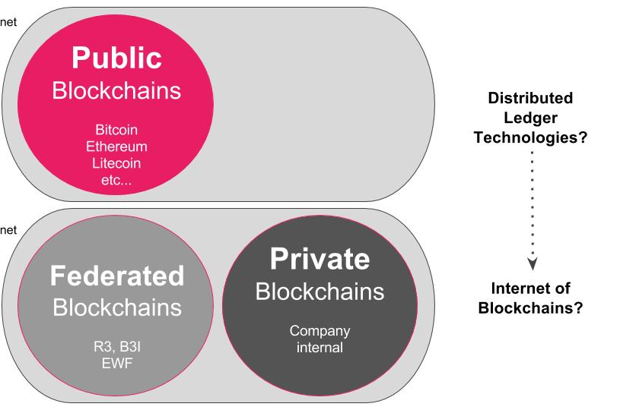

Slide 5
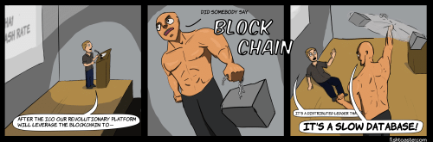
BlockChain is…

Slide 6
…not a slow database.
A blockchain is a ledger.
A blockchain is immutable.
A blockchain is distributed.
A blockchain is not ‘slow’ or ‘inefficient’.

Slide 7
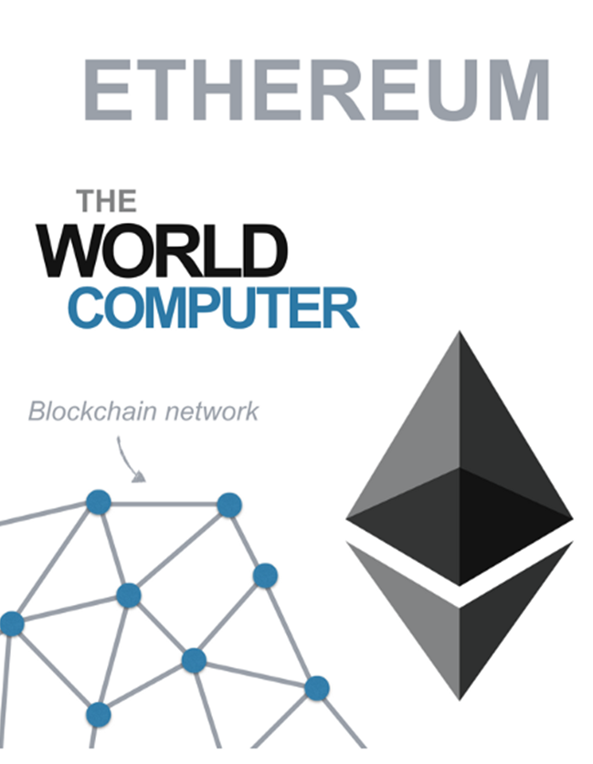

Slide 8
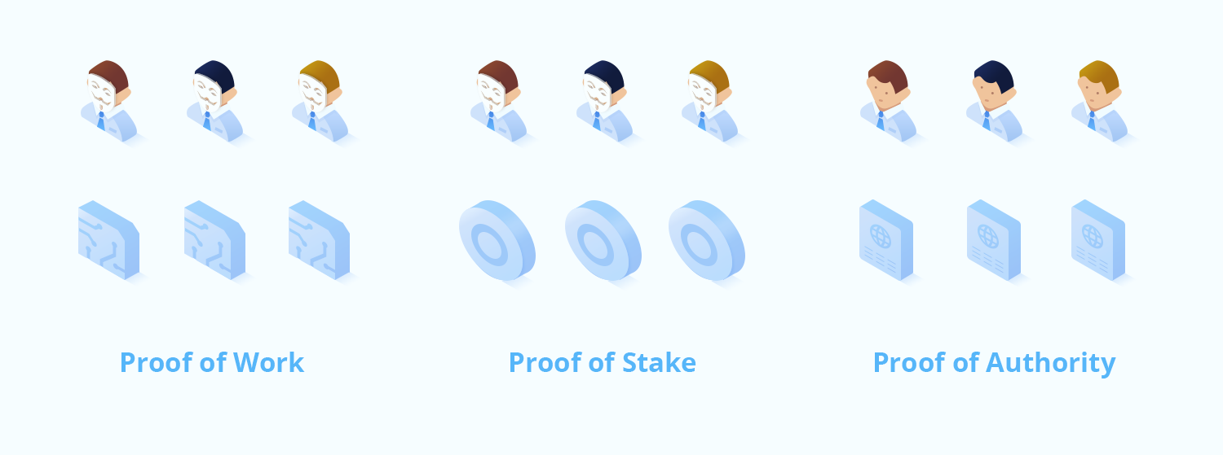
Consensus and Block Verification

Slide 9
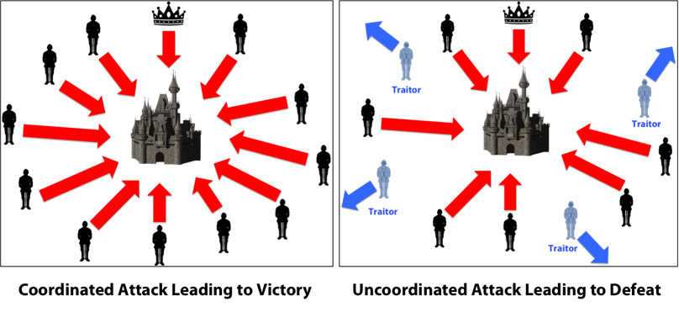
Byzantine fault
All faithful generals make the same final decision
A small number of traitors can not cause a bad final decision

Slide 10
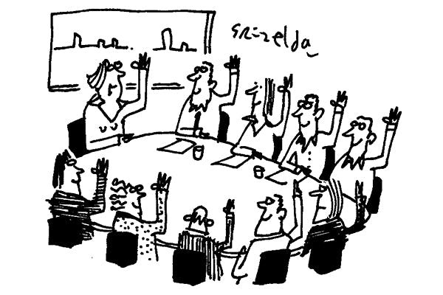

Slide 11
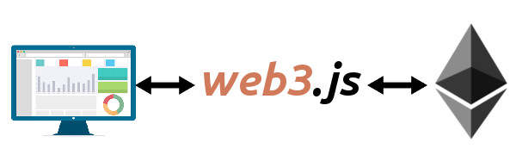
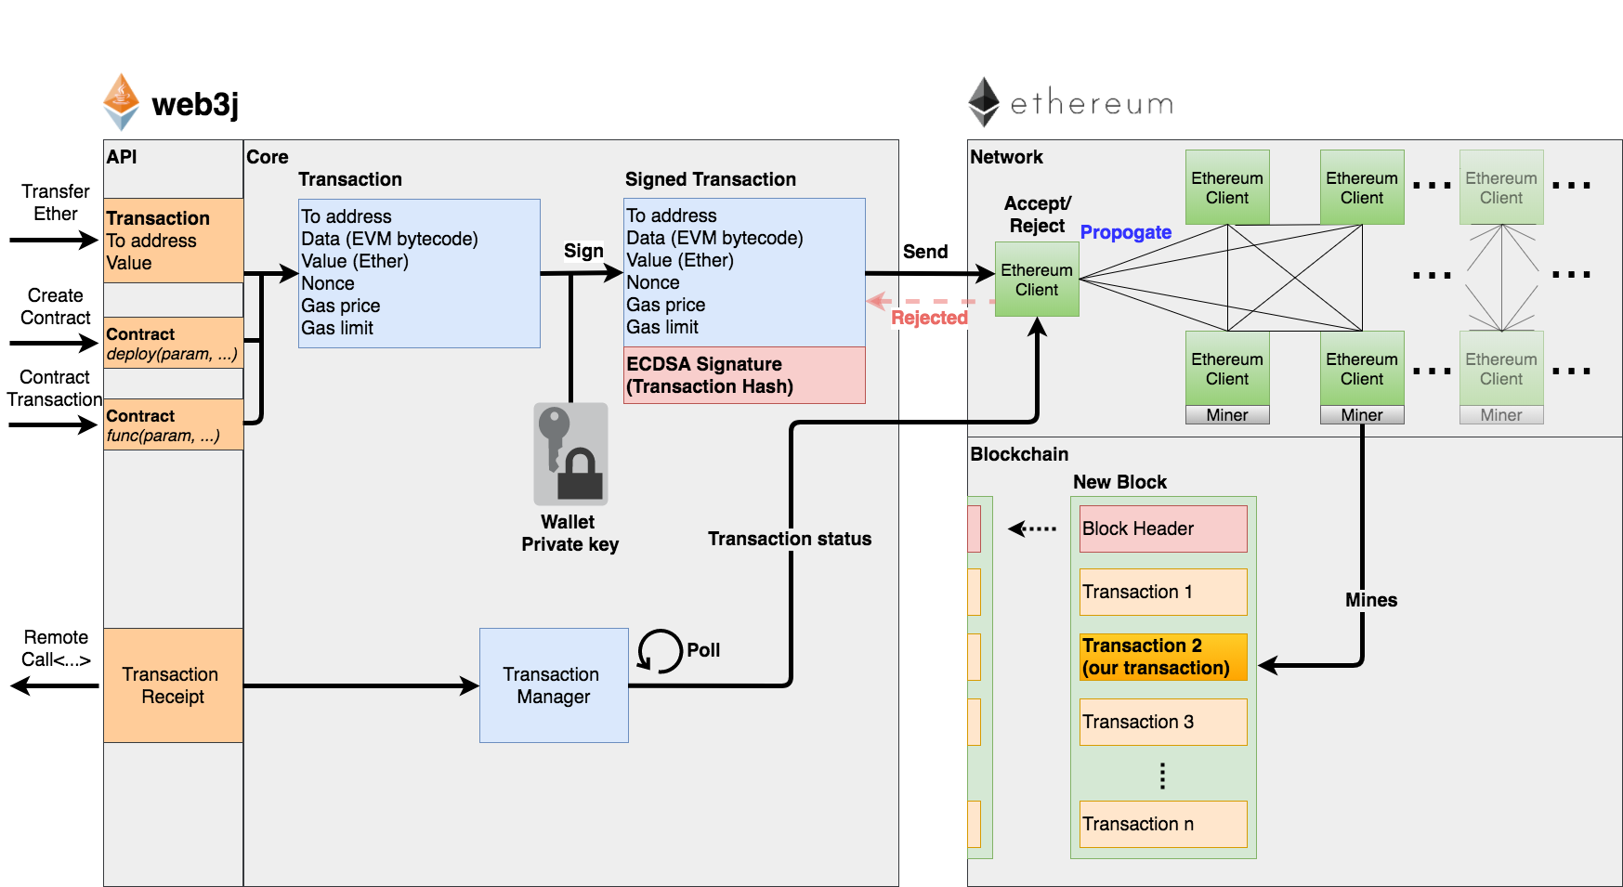

Slide 12
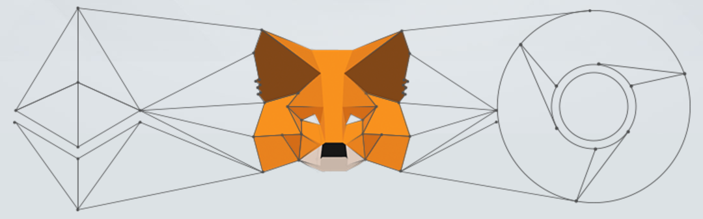
MetaMask

Slide 13


Truffle & Ganache

Slide 14

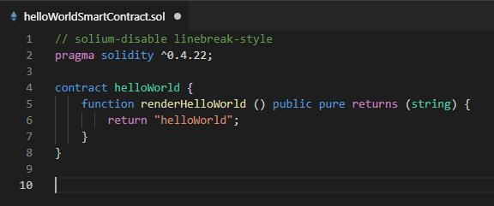
Solidity

Slide 15
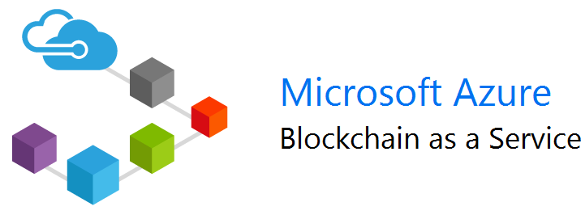

Slide 16
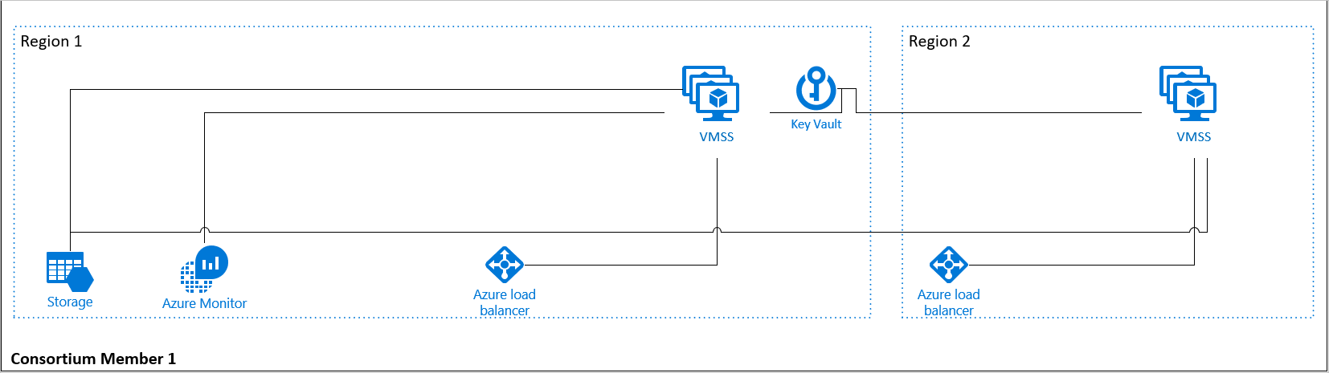

Slide 17


Slide 18
DEMO
Azure BaaS

Slide 19
Cons
ETH Foundation
short time between block verification (uncle block, uncle chain)
lack of private channels
ETH has no hard cap
Active Development

Slide 20
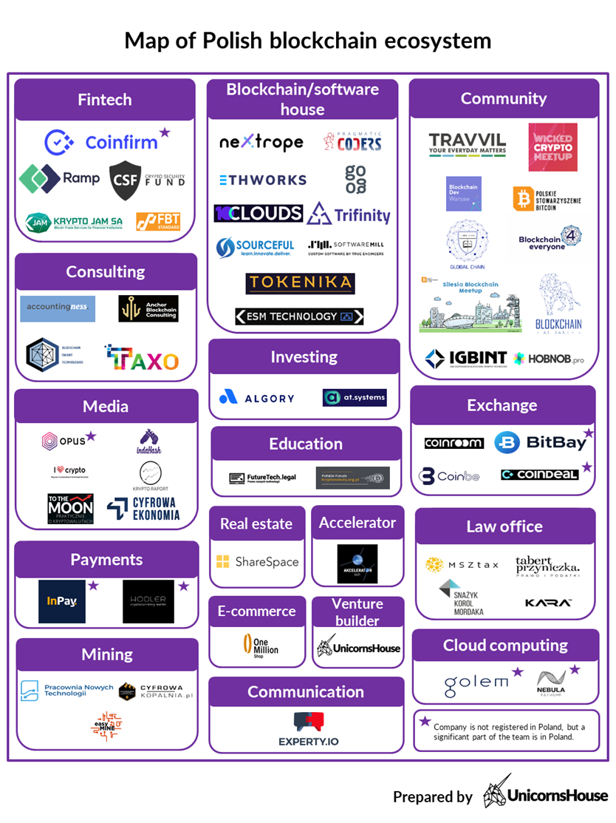

Slide 21
PLATINUM SPONSOR
GOLD SPONSORS
SILVER SPONSOR
BRONZE SPONSOR
STRATEGIC PARTNER

